Slide 1


TestMagic Training
TestMagic^{TM -} An AI driven Enterprise Test Automation Platform

Slide 2
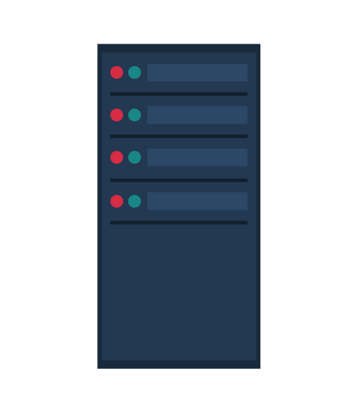





TestMagic Automation Platform Architecture
TestMagic ALM Server Requirement
Windows Server 2012 or higher
IIS 10.0 or higher
32 GB RAM or higher
64 bit OS
.NET Framework 4.7.2 or above
Storage: 100 GB and above
Database Server Requirement
Windows Server 2012 or higher
Processor: Dual Core or higher
32 GB RAM or higher
64 bit OS
MS SQL server
Storage: 100 GB and above
eZAutomate Component Requirement
Windows 7 SP1 Professional or higher
8 GB RAM or higher
64 bit OS
Storage: 50 GB
Server
Database
Client

Slide 3
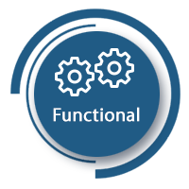

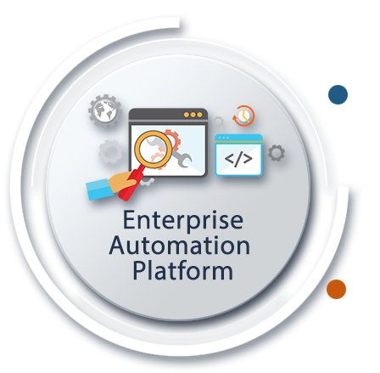







TestMagicTM A SaaS compliant As Automation Platform
Test Execution
Report DB
Master
Configuration DB
6.X – An Enterprise Automation Platform
Automation Artifacts DB
ALM Server
VM/Azure/AWS/Citrix
DB Server
VM /Azure/AWS/Citrix
1
n
TestMagic
Automation Lifecycle and Defect Management (ALM)
eZAutomate
AI-enabled Learning and Performing Engine
MagicSchedular
AI-enabled Execution Auto Test Execution Distribution
Client
Client
Client Machines
Physical / VM / Azure / AWS / Citrix / Dockers
1
1
n
n
1
n
Client
Client

Slide 4




TestMagicTM – Various Component of TestMagicTM
Test Automation Creation
Test Automation Execution
Test Execution Reporting & Analysis

Slide 5









TestMagicTM – Business Process Techniques….
Manual Execution
Wire Frame(s)
Screenshots/
FSD/BRD
BPT (Business Process Testing) Techniques
Business Component(s)
Data Parameterization
Automated Execution
Business Process Workflow(s) Creation
Test Verification Report
Video Recording of Test Execution
Automation Test Suite(s) Creation

Slide 6

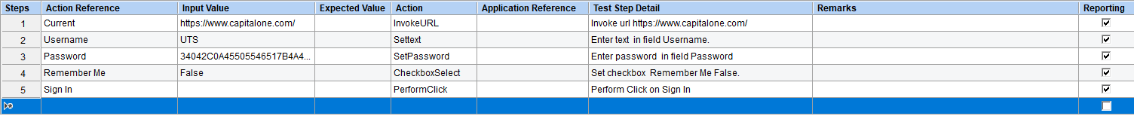
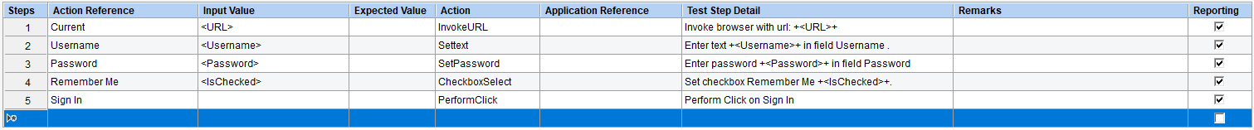
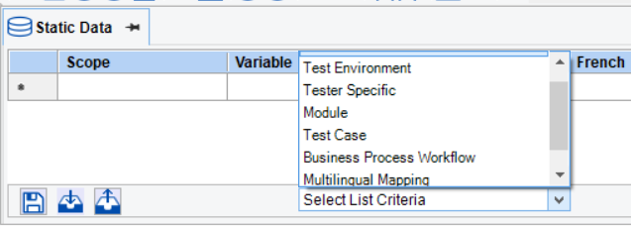
TestMagicTM - Business Component Overview
Notes:
Object Repository, Data Parameterization

Slide 7
TestMagicTM - Business Component Authoring (Zero Coding)
TestMagic allows 4 ways to user for automatic authoring of Business Component which needs Zero programming skills.
Discover
Learn
Offline
UI Vision
Opening URL in browser and clicking on the Discover icon captures automatically all the visual reference(s), input data and actions to be performed in the grid format with structured NLP details as Test Step details.
For every new page Discover option is clicked to capture all above information automatically for the selected object types..
Each Business Component(s) input values are parametrized automatically by clicking on auto parameterization option and controlled by inbuilt version management.
This option enables capturing user journeys or exploratory tests on the application and saving as Business Component(s); controlled by inbuilt version management.
These created Business Components are data parameterized and linked with inbuilt or external test data sources.
Learn-on is a simple and quick process and uses machine learning algorithm to capture all the information and action performed by the user.
This option is used to automate test when application is still not developed. Zero lead time required for automation hence enable automation testing from Day 1.
It enables capturing user journeys using Wire frames/ Screenshots/ offline HTML pages.
Business Components are either created using visual references or Images of the objects.
Created Business Component(s) are controlled by inbuilt version management and Data parameterization can be linked with inbuilt or external test data sources.
This option is used to navigate to objects with the help of Image based capturing.
This method of creation includes snipping of object images, instead of any visual references.

Slide 8
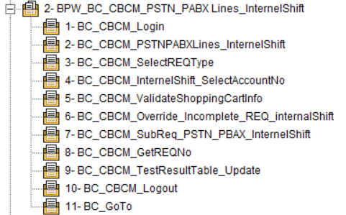
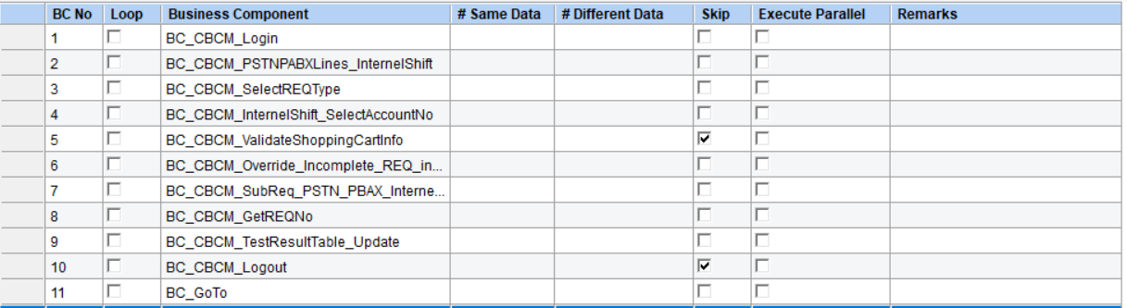
TestMagicTM - Business Process Workflow Overview
Notes:
Drag Drop of BC, Multiple Iteration, Parallel Execution, BC Skipping

Slide 9
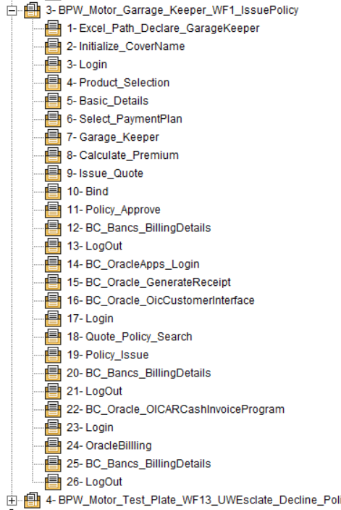
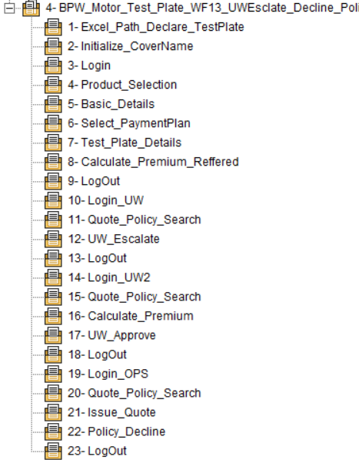
TestMagicTM - Business Process Workflow Overview
Notes:
Reusability; Framework; Agile Development; Continuous Testing

Slide 10
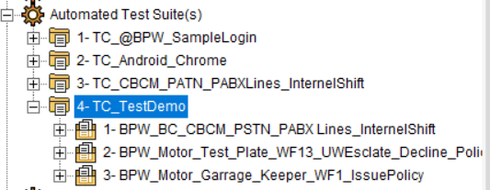
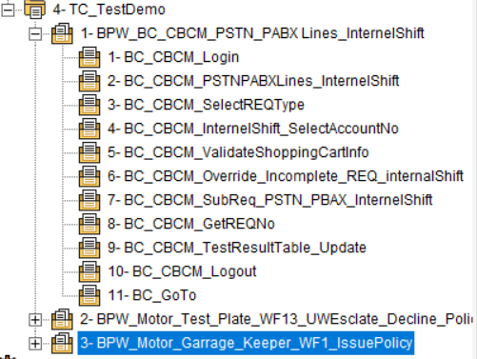
TestMagicTM - Automation Test Suite(s) Overview
Notes:
Drag Drop of BC, Multiple Iteration, Parallel Execution, BC Skipping

Slide 11
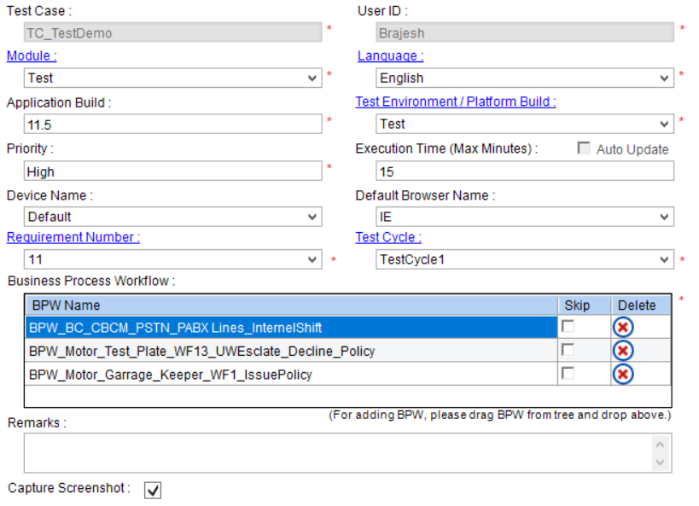
TestMagicTM - Automation Test Suite(s) Overview
Notes:
Reusability; Framework; Agile Development; Continuous Testing

Slide 12















TestMagicTM – Artificial Intelligence (AI/ML Capabilities)
Object Identification
Discover Application
Under Test
Test Case
Authoring
Computer
Vision
AI in Test Automation Creation
Auto Load
Balancer
Exception Handling
STA^{A}M^{A}P
And iAutoHeal
Auto Sync
AI in Test Automation Execution
Auto Blocking and Unblocking
Test Case based
on Defect Report Analysis
Discover Application
Stability
based on Execution Analysis
Perspective Analytics
AI in Execution Reporting & Analysis

Slide 13
Thank You

